Slide 1

INSTITUTE - UIE
DEPARTMENT- ACADEMIC UNIT-2
Bachelor of Engineering (Computer Science & Engineering)
Subject Name: Introduction to Problem Solving
Code:22CSH-101
Structure: Structure and functions, Structures and pointers
DISCOVER . LEARN . EMPOWER

Slide 2


Introduction to Problem Solving
Course Objectives
The course aims to provide exposure to problem-solving through programming.
The course aims to raise the programming skills of students via logic building capability.
With knowledge of C programming language, students would be able to model real world problems.

Slide 3



Course Outcomes
CO Number | Course Outcome
CO1 | Remember the concepts related to fundamentals of C language, draw flowcharts and write algorithm/pseudocode.
CO2 | Understand the way of execution and debug programs in C language.
CO3 | Apply various constructs, loops, functions to solve mathematical and scientific problem.
CO4 | Analyze the dynamic behavior of memory by the use of pointers.
CO5 | Design and develop modular programs for real world problems using control structure and selection structure.

Slide 4
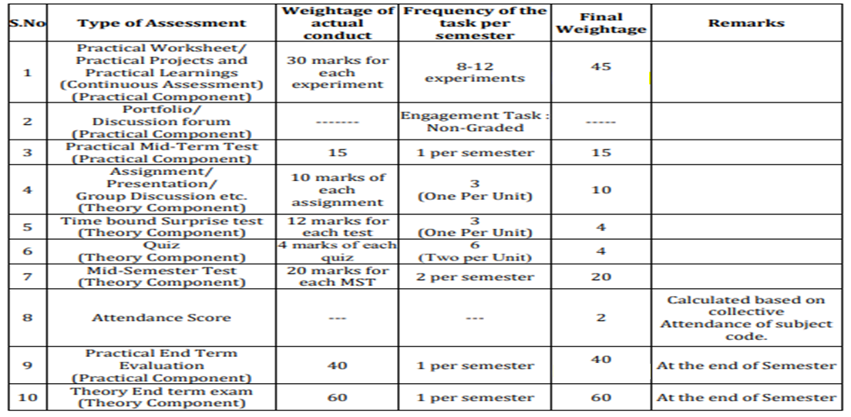
Scheme of Evaluation

Slide 5
Structures and Functions
A structure can be passed to any function from main function or from any sub function.
Structure definition will be available within the function only.
It won’t be available to other functions unless it is passed to those functions by value or by address(reference).
Else, we have to declare structure variable as global variable. That means, structure variable should be declared outside the main function. So, this structure will be visible to all the functions in a C program.

Slide 6
PASSING ENTIRE STRUCTURE TO FUNCTION IN C
It can be done in below 3 ways.
Passing structure to a function by value
Passing structure to a function by address(reference)
No need to pass a structure – Declare structure variable as global

Slide 7
Passing Structure to Function by Value
It means the whole structure is passed to another function with all members and their values.
So, this structure can be accessed from called function.
This concept is very useful while writing very big programs in C.
Example:
#include <stdio.h>
#include <string.h>
struct student
{
int id;
char name[20];
float percentage;
};
void func(struct student record);

Slide 8
int main()
{
struct student record;
record.id=1;
strcpy(record.name, "Raju");
record.percentage = 86.5;
func(record);
return 0;
}
void func(struct student record)
{
printf(" Id is: %d \n", record.id);
printf(" Name is: %s \n", record.name);
printf(" Percentage is: %f \n", record.percentage);
}
Output:
Id is: 1
Name is: Raju
Percentage is: 86.500000

Slide 9
Passing Structure to Function by Address (reference)
It means only the address of the structure is passed to another function.
The whole structure is not passed to another function with all members and their values.
So, this structure can be accessed from called function by its address.
Example:
#include <stdio.h>
#include <string.h>
struct student
{
int id;
char name[20];
float percentage;
};

Slide 10
void func(struct student *record);
int main()
{
struct student record;
record.id=1;
strcpy(record.name, "Raju");
record.percentage = 86.5;
func(&record);
return 0;
}
void func(struct student *record)
{
printf(" Id is: %d \n", record->id);
printf(" Name is: %s \n", record->name);
printf(" Percentage is: %f \n", record->percentage);
}
Output:
Id is: 1
Name is: Raju
Percentage is: 86.500000

Slide 11
Declare structure variable as global
Structure variables also can be declared as global variables as we declare other variables in C.
So, When a structure variable is declared as global, then it is visible to all the functions in a program.
In this scenario, we don’t need to pass the structure to any function separately.
Example:
#include <stdio.h>
#include <string.h>
struct student
{
int id;
char name[20];
float percentage;
};

Slide 12
struct student record; // Global declaration of structure
void structure_demo();
int main()
{
record.id=1;
strcpy(record.name, "Raju");
record.percentage = 86.5;
structure_demo();
return 0;
}
void structure_demo()
{
printf(" Id is: %d \n", record.id);
printf(" Name is: %s \n", record.name);
printf(" Percentage is: %f \n", record.percentage);
}
Output:
Id is: 1
Name is: Raju
Percentage is: 86.500000

Slide 13
Passing individual structure members
We can pass individual members to a function just like ordinary variables.
The following program demonstrates how to pass structure members as arguments to the function.
Example:
#include<stdio.h>
/*
structure is defined above all functions so it is global.
*/
struct student
{
char name[20];
int roll_no;
int marks;
};
void print_struct(char name[], int roll_no, int marks);

Slide 14
int main()
{
struct student stu = {"Tim", 1, 78};
print_struct(stu.name, stu.roll_no, stu.marks);
return 0;
}
void print_struct(char name[], int roll_no, int marks)
{
printf("Name: %s\n", name);
printf("Roll no: %d\n", roll_no);
printf("Marks: %d\n", marks);
printf("\n");
}
Output:
Name: Tim
Roll no: 1
Marks: 78

Slide 15
Returning Structure Variable from a Function
To return a structure from a function the return type should be a structure only.
Example:
// C++ program to return a structure from a function using Call By Value Method
#include <iostream>
#include <stdlib.h>
using namespace std;
// required structure
struct Employee {
int Id;
string Name;
};

Slide 16
// return type of the function is structure
Employee data(Employee E)
{
// Assigning the values to elements
E.Id = 45;
E.Name = "aman";
Output:
Employee Id: 45
Employee Name: aman
// returning structure
return (E);
}
// Driver code
int main()
{
// creating object of Employee
Employee Emp;
// calling function data to assign value
Emp = data(Emp);
// display the output
cout << "Employee Id: " << Emp.Id;
cout << "\nEmployee Name: " << Emp.Name;
return 0;
}
Output:
Employee Id: 45
Employee Name: aman

Slide 17
Summary
Structure definition will be available within the function only.
A structure can be passed to any function from main function or from any sub function.
It won’t be available to other functions unless it is passed to those functions by value or by address
We can also initialize the array of structures using the same syntax as that for initializing arrays.
To access members of a structure using pointers, we use the -> operator.
Else, we have to declare structure variable as global variable. That means, structure variable should be declared outside the main function. So, this structure will be visible to all the functions in a C program.

Slide 18
Frequently Asked Questions
Q1 Write a Program to enter the employee Information & display the data passing Structures By Using Pointers
Expected Output:
Enter the name of the Employee : John
Enter the Employee Id : 16
Enter Experience of the Employee : 3
---------Details List---------
Employee Name : ram
Employee Id : 16
Employee Experience : 3
Solution:

Slide 19
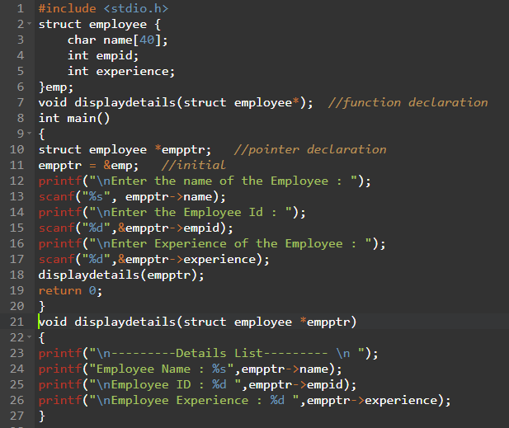

Slide 20
Assessment Questions:
1. Write a Program to demonstrate How to return multiple values from a function in C?
2. Program to add two distances in inch-feet system(Passing structure).

Slide 21

Discussion forum
PROBLEM:
Write a Program to add two complex numbers Using (Passing struct by reference).

Slide 22

REFERENCES
Reference Books
Programming in C by Reema Thareja.
Programming in ANSI C by E. Balaguruswamy, Tata McGraw Hill.
Programming with C (Schaum's Outline Series) by Byron Gottfried Jitender Chhabra, Tata McGraw Hill.
The C Programming Language by Brian W. Kernighan, Dennis Ritchie, Pearson education.
Websites:
https://fresh2refresh.com/c-programming/c-passing-struct-to-function/
https://www.geeksforgeeks.org/how-to-pass-or-return-a-structure-to-from-a-function-in-c-c/
https://www.studytonight.com/c/pointers-to-structure-in-c.php
https://dev.to/mikkel250/structures-and-pointers-in-c-n6i
https://www.programiz.com/c-programming/c-structures-pointers
YouTube Links:
https://www.youtube.com/watch?v=4HC8X966Q5M
https://www.youtube.com/watch?v=VF40lxbXR_0

Slide 23
THANK YOU

